Slide 1
Python for data analysis: introduction to Pandas
PyLadies BCN
december 2015

Slide 2
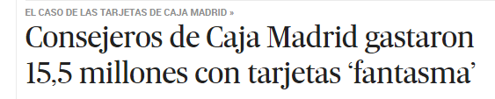
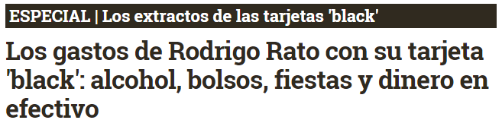
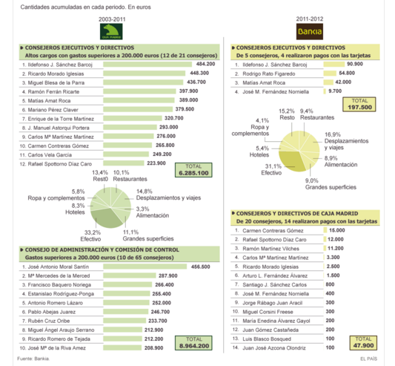
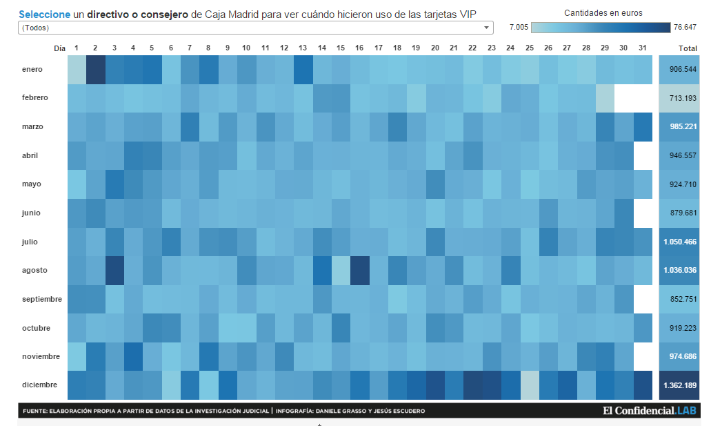

Slide 3
import pandas as pd
Problems?
import sys reload(sys) sys.setdefaultencoding('utf8')

Slide 4
READ INFO
From CSV
df = pd.read_csv(“tarjetas.csv”)
From Excel
pd.read_excel()
From JSON
pd.read_json()

Slide 5
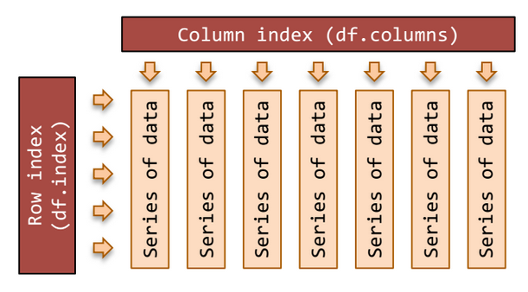
STRUCTURE

Slide 6
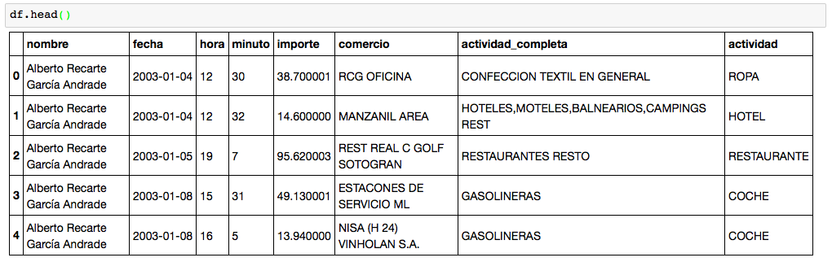
STRUCTURE

Slide 7
START EXPLORING
df.index
df.columns
df.shape
df.head(10)
df.tail(20)

Slide 8
SELECTING
By column
df[“fecha”]
df[[“fecha”, “nombre”]].head()
df.filter([“nombre”, “actividad”])

Slide 9
SELECTING
By row
df.iloc[5000]
df.ix[5000]
df.ix[5130:5135]

Slide 10
SELECTING
By value df.loc[df[“nombre”] == “Rodrigo de Rato Figaredo” ]
df.loc[df["importe"] >= 10000]
rato = df[df["nombre"].str.contains("Rato")]
Are there missing values?
df[df["actividad_completa"].str.contains("IBERIA", na=False)]

Slide 11
SORTING & TRANSPOSING
df.sort(“importe”, ascending=False)
df.T

Slide 12
MATH & STATS
df.describe()
df[“importe”].max()
df[“importe”].min()
df[“importe”].mean()
df[“importe”].median()
df[“importe”].std()
df[“importe”].cumsum()
df[“importe”].sum()

Slide 13
GROUPBY == PIVOT TABLES / TABLAS DINÁMICAS
df[“importe”].groupby(df[“actividad”]).mean()

Slide 14
DATES
df.dtypes
df["fecha2"] = pd.to_datetime(df["fecha"])
df2 = df.sort("fecha2")

Slide 15
WRITE
df.to_csv('mynewcsv.csv', encoding='utf-8')

Slide 16
YOUR TURN!
How much did “El Corte Inglés” win?
eci = df.loc[df["actividad_completa"] == "EL CORTE INGLES"]
Who is the biggest spender?
Who paid for “Funerarias”?
….

Slide 17
Cheat Sheet #1
https://drive.google.com/folderview?id=0ByIrJAE4KMTtaGhRcXkxNHhmY2M
Cheat Sheet #2
https://s3.amazonaws.com/quandl-static-content/Documents/Quandl+-+Pandas,+SciPy,+NumPy+Cheat+Sheet.pdf

